Slide 1
Chapter 16: Query Optimization

Slide 2
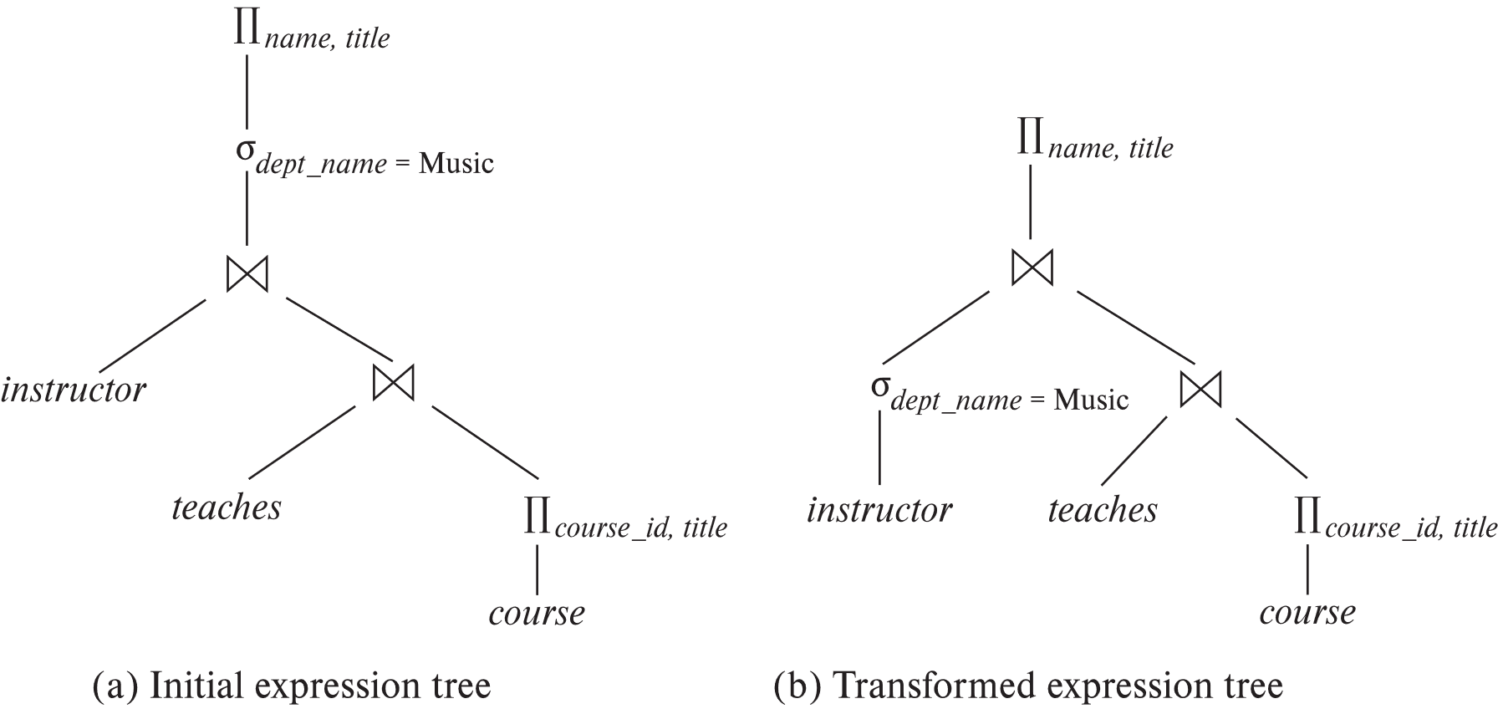
Introduction
Alternative ways of evaluating a given query
Equivalent expressions

Slide 3
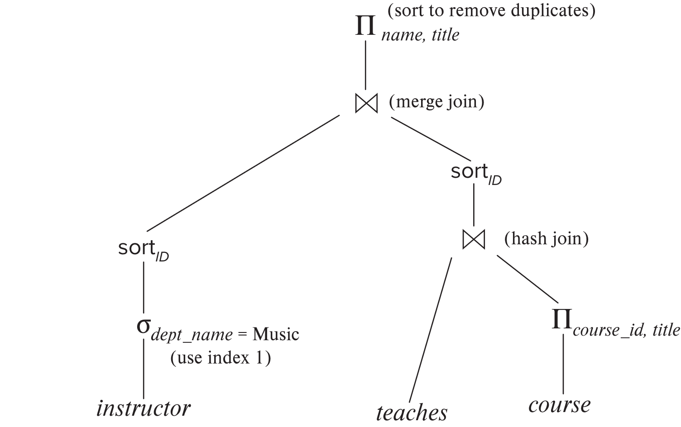
Introduction (Cont.)
Alternative ways of evaluating a given query
Different algorithms for each operation
An evaluation plan defines exactly what algorithm is used for each operation, and how the execution of the operations is coordinated.

Slide 4
Introduction (Cont.)
Cost difference between evaluation plans for a query can be enormous
E.g., seconds vs. days in some cases
Steps in cost-based query optimization
1. Generate logically equivalent expressions using equivalence rules
2. Choose the cheapest plan based on estimated cost
Estimation of plan cost based on:
Statistical information about relations. Examples:
number of tuples, number of distinct values for an attribute
Statistics estimation for intermediate results
to compute cost of complex expressions

Slide 5
Viewing Query Evaluation Plans
Most database support explain <query>
Displays plan chosen by query optimizer, along with cost estimates
Some syntax variations between databases
Oracle: explain plan for <query> followed by select * from table (dbms_xplan.display)
SQL Server: set showplan_text on
Some databases (e.g. PostgreSQL) support explain analyse <query>
Shows actual runtime statistics found by running the query, in addition to showing the plan
Some databases (e.g. PostgreSQL) show cost as f..l
f is the cost of delivering first tuple and l is cost of delivering all results

Slide 6
Generating Equivalent Expressions

Slide 7
Equivalence Rules
1. Conjunctive selection operations can be deconstructed into a sequence of individual selections. σ_{θ1 ∧ θ2} (E) ≡ σ_{θ1} (σ_{θ2} (E))
2. Selection operations are commutative. σ_{θ1}(σ_{θ2}(E)) ≡ σ_{θ2} (σ_{θ1}(E))
3. Only the last in a sequence of projection operations is needed, the others can be omitted. ∏ _{L1}(∏ _{L2}(…(∏ _{Ln}(E))…)) ≡ ∏ _{L1}(E) where L₁ ⊆ L₂ … ⊆ L_{n}
4. Selections can be combined with Cartesian products and theta joins.
σ_{θ} (E₁ x E₂) ≡ E₁ ⨝ _{θ} E₂
σ _{θ1} (E₁ ⨝_{θ2} E₂) ≡ E₁ ⨝ _{θ1∧θ2} E₂

Slide 8
Equivalence Rules (Cont.)
5. Theta-join operations (and natural joins) are commutative. E₁ ⨝ E₂ ≡ E₂ ⨝ E₁
6. (a) Natural join operations are associative:
(E₁ ⨝ E₂) ⨝ E₃ ≡ E₁ ⨝ (E₂ ⨝ E₃) (b) Theta joins are associative in the following manner: (E₁ ⨝ _{θ1} E₂) ⨝ _{θ2 ∧ θ3} E₃ ≡ E₁ ⨝_{θ1 ∧ θ3} (E₂ ⨝ _{θ2} E₃) where θ₂ involves attributes from only E₂ and E₃.

Slide 9
Equivalence Rules (Cont.)
7. The selection operation distributes over the theta join operation under the following two conditions: (a) When all the attributes in θ₀ involve only the attributes of one of the expressions (say E₁) being joined. σ_{θ0} (E₁ ⨝_{θ} E₂) ≡ (σ_{θ0}(E₁)) ⨝_{θ} E₂
(b) When θ₁ involves only the attributes of E₁ and θ₂ involves only the attributes of E₂.
σ_{θ1 ∧ θ2} (E₁ ⨝_{θ} E₂) ≡ (σ_{θ1}(E₁)) ⨝_{θ} (σ_{θ2}(E₂))

Slide 10
Equivalence Rules (Cont.)
8. The projection operation distributes over the theta join operation as follows:
(a) if θ involves only attributes from L₁ ∪ L₂: ∏ _{L1 ∪ L2}(E₁ ⨝_{θ} E₂) ≡ ∏ _{L1}(E₁) ⨝_{θ} ∏ _{L2}(E₂)
(b) In general, consider a join E₁ ⨝_{θ} E₂.
Let L₁ and L₂ be sets of attributes from E₁ and E₂, respectively.
Let L₃ be attributes of E₁ that are involved in join condition θ, but are not in L₁ ∪ L₂, and
let L₄ be attributes of E₂ that are involved in join condition θ, but are not in L₁ ∪ L₂. ∏ _{L1 ∪ L2}(E₁ ⨝_{θ} E₂) ≡ ∏ _{L1 ∪ L2}(∏ _{L1 ∪ L3}(E₁) ⨝_{θ} ∏ _{L2 ∪ L4}(E₂))
Similar equivalences hold for outerjoin operations: ⟕, ⟖, and ⟗

Slide 11
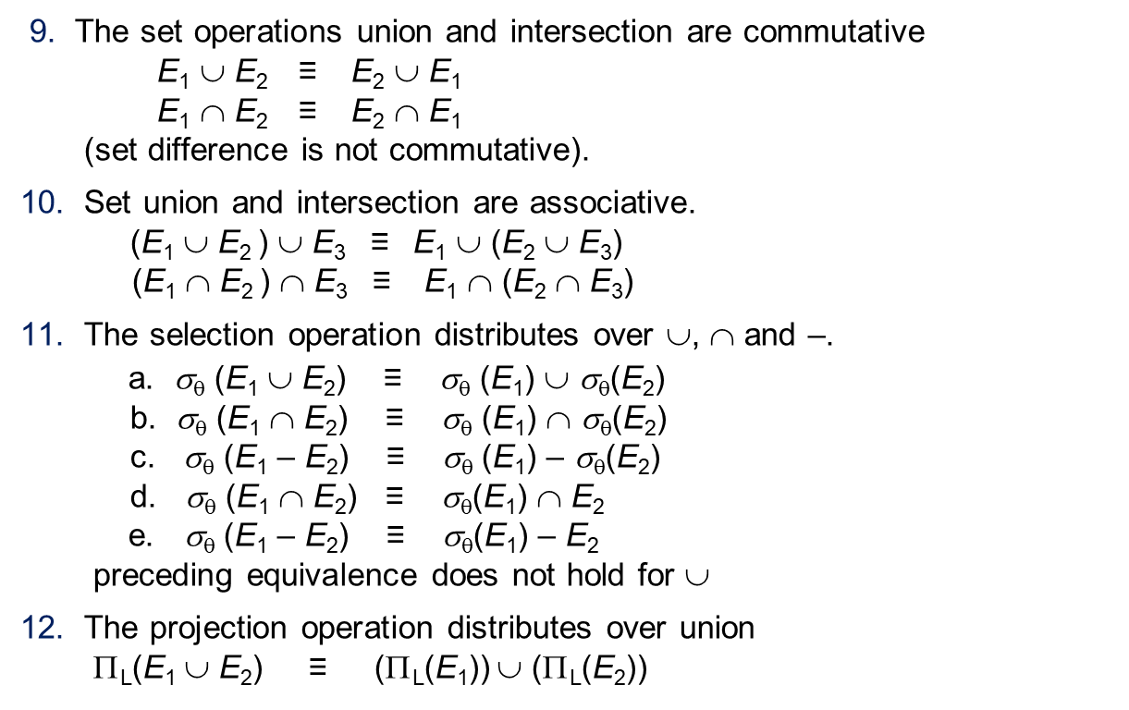
Equivalence Rules (Cont.)
9. The set operations union and intersection are commutative E₁ ∪ E₂ ≡ E₂ ∪ E₁ E₁ ∩ E₂ ≡ E₂ ∩ E₁ (set difference is not commutative).
10. Set union and intersection are associative. (E₁ ∪ E₂ ) ∪ E₃ ≡ E₁ ∪ (E₂ ∪ E₃) (E₁ ∩ E₂ ) ∩ E₃ ≡ E₁ ∩ (E₂ ∩ E₃)
11. The selection operation distributes over ∪, ∩ and –. a. σ_{θ} (E₁ ∪ E₂) ≡ σ_{θ} (E₁) ∪ σ_{θ}(E₂) b. σ_{θ} (E₁ ∩ E₂) ≡ σ_{θ} (E₁) ∩ σ_{θ}(E₂) c. σ_{θ} (E₁ – E₂) ≡ σ_{θ} (E₁) – σ_{θ}(E₂) d. σ_{θ} (E₁ ∩ E₂) ≡ σ_{θ}(E₁) ∩ E₂ e. σ_{θ} (E₁ – E₂) ≡ σ_{θ}(E₁) – E₂ preceding equivalence does not hold for ∪
12. The projection operation distributes over union Π_{L}(E₁ ∪ E₂) ≡ (Π_{L}(E₁)) ∪ (Π_{L}(E₂))

Slide 12
Equivalence Rules (Cont.)
13. Selection distributes over aggregation as below σ_{θ}(_{G}𝛾_{A}(E)) ≡ _{G}𝛾_{A}(σ_{θ}(E)) provided θ only involves attributes in G
14. a. Full outerjoin is commutative: E₁ ⟗ E₂ ≡ E₂ ⟗ E₁ b. Left and right outerjoin are not commutative, but: E₁ ⟕ E₂ ≡ E₂ ⟖ E₁
15. Selection distributes over left and right outerjoins as below, provided θ₁
only involves attributes of E₁ a. σ_{θ1} (E₁ ⟕_{θ} E₂) ≡ (σ_{θ1} (E₁)) ⟕_{θ} E₂ b. σ_{θ1} (E₁ ⟖_{θ} E₂) ≡ E₂ ⟕_{θ} (σ_{θ1} (E₁))
16. Outerjoins can be replaced by inner joins under some conditions
a. σ_{θ1} (E₁ ⟕_{θ} E₂) ≡ σ_{θ1} (E₁ ⨝_{θ} E₂) b. σ_{θ1} (E₁ ⟖_{θ} E₁) ≡ σ_{θ1} (E₁ ⨝_{θ} E₂) provided θ₁ is null rejecting on E₂

Slide 13
Equivalence Rules (Cont.)
Note that several equivalences that hold for joins do not hold for outerjoins
σ_{year=2017}(instructor ⟕ teaches) ≢ σ_{year=2017}(instructor ⨝ teaches)
Outerjoins are not associative (r ⟕ s) ⟕ t ≢ r ⟕ (s ⟕ t)
e.g. with r(A,B) = {(1,1), s(B,C) = { (1,1)}, t(A,C) = { }
Notes:
How about (r ⟕ s) ⟕ t vs (r ⟕ t) ⟕ s assuming r has common attributes with s and t? Hint: consider 2 cases where s and t have common attributes and those where they have no common attribute

Slide 14
Transformation Example: Pushing Selections
Query: Find the names of all instructors in the Music department, along with the titles of the courses that they teach
Π_{name, title}(σ_{dept_name= ‘Music’} (instructor ⨝ (teaches ⨝ Π_{course_id, title} (course))))
Transformation using rule 7a.
Π_{name, title}((σ_{dept_name= ‘Music’}(instructor)) ⨝ (teaches ⨝ Π_{course_id, title} (course)))
Performing the selection as early as possible reduces the size of the relation to be joined.

Slide 15
Example with Multiple Transformations
Query: Find the names of all instructors in the Music department who have taught a course in 2017, along with the titles of the courses that they taught
Π_{name, title}(σ_{dept_name= "Music”∧year = 2017} (instructor ⨝ (teaches ⨝ Π_{course_id, title} (course))))
Transformation using join associatively (Rule 6a):
Π_{name, title}(σ_{dept_name= “Music”∧year = 2017} ((instructor ⨝ teaches) ⨝ Π_{course_id, title} (course)))
Second form provides an opportunity to apply the “perform selections early” rule, resulting in the subexpression
σ_{dept_name = “Music”} (instructor) ⨝ σ _{year = 2017} (teaches)

Slide 16
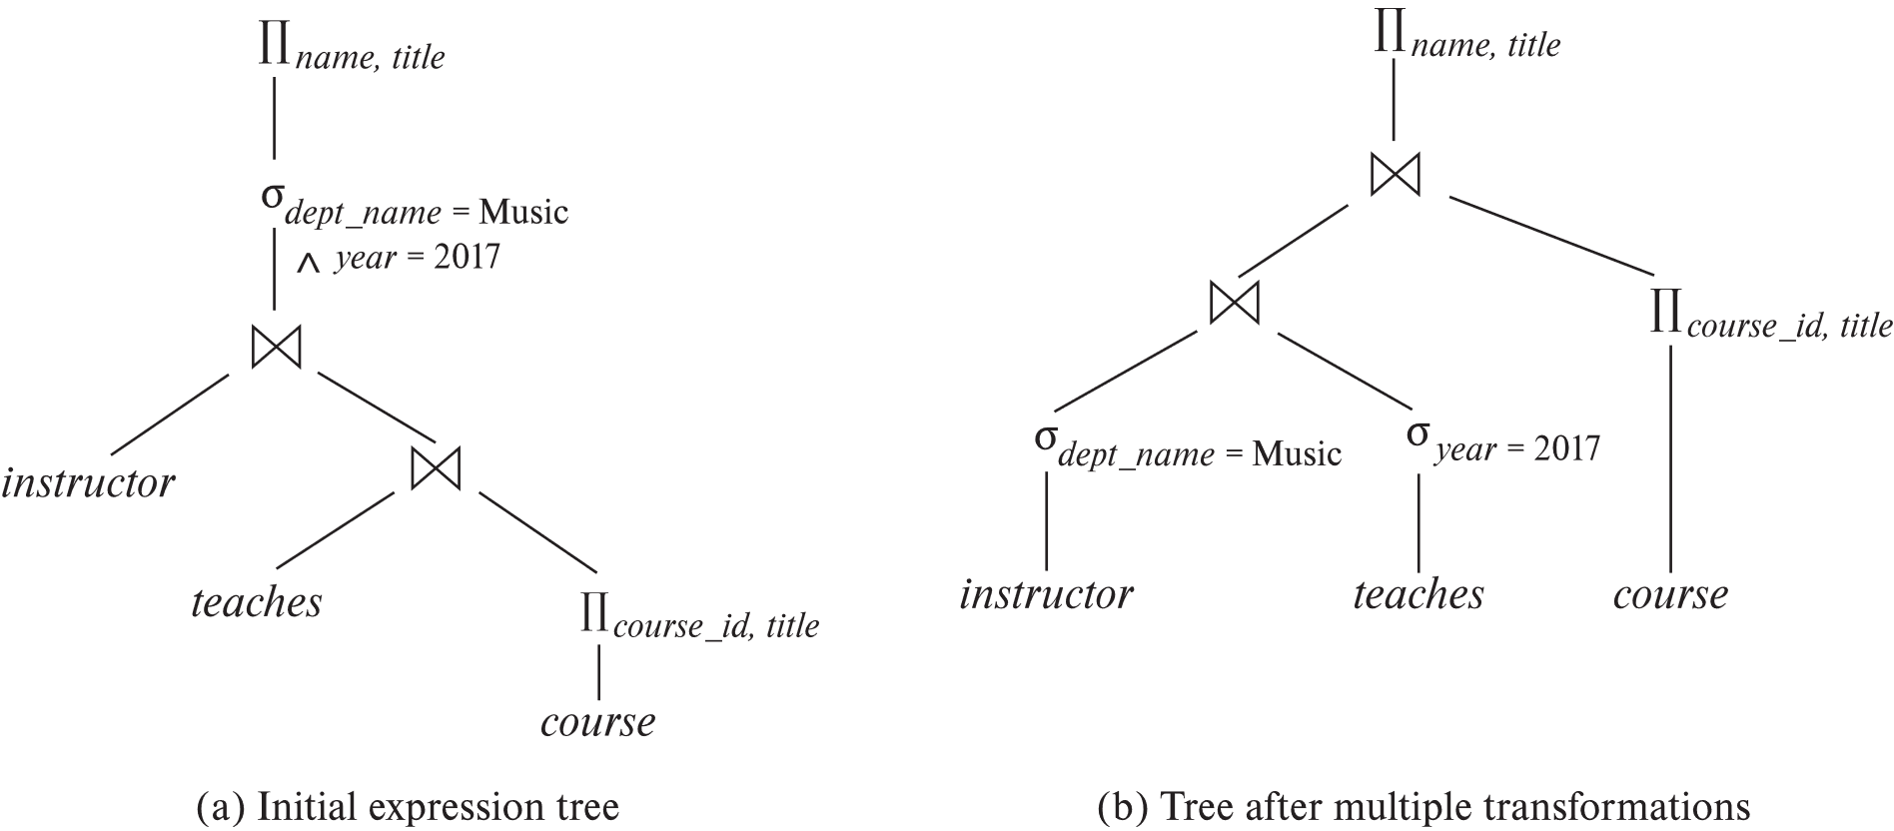
Multiple Transformations (Cont.)

Slide 17
Join Ordering Example
For all relations r_{1,} r_{2,} and r₃,
(r₁ ⨝ r₂) ⨝ r₃ = r₁ ⨝ (r₂ ⨝ r₃ )
(Join Associativity) ⨝
If r₂ ⨝ r₃ is quite large and r₁ ⨝ r₂ is small, we choose
(r₁ ⨝ r₂) ⨝ r₃
so that we compute and store a smaller temporary relation.

Slide 18
Join Ordering Example (Cont.)
Consider the expression
Π_{name, title}(σ_{dept_name= “Music”} (instructor) ⨝ teaches) ⨝ Π_{course_id, title} (course))))
Could compute teaches ⨝ Π_{course_id, title} (course) first, and join result with σ_{dept_name= “Music”} (instructor) but the result of the first join is likely to be a large relation.
Only a small fraction of the university’s instructors are likely to be from the Music department
it is better to compute
σ_{dept_name= “Music”} (instructor) ⨝ teaches
first.

Slide 19
Choice of Evaluation Plans
Query optimizers use equivalence rules to generate expressions equivalent to the given expression
2. Cost of each operator computed as described in query evaluation chapter
Need statistics of input relations
E.g., number of tuples, sizes of tuples, number of distinct values for an attribute
3. Search all the plans and choose the best plan in a cost-based fashion
Or use heuristics to choose a plan

Slide 20
Heuristic Optimization
Cost-based optimization is expensive
Systems may use heuristics to reduce the number of choices that must be made in a cost-based fashion.
Heuristic optimization transforms the query-tree by using a set of rules that typically (but not in all cases) improve execution performance:
Perform selection early (reduces the number of tuples)
Perform projection early (reduces the number of attributes)
Perform most restrictive selection and join operations (i.e., with smallest result size) before other similar operations.
Some systems use only heuristics, others combine heuristics with partial cost-based optimization.

Slide 21
Statistics for Cost Estimation

Slide 22
Statistical Information for Cost Estimation
n_{r}: number of tuples in a relation r.
b_{r}: number of blocks containing tuples of r.
l_{r}: size of a tuple of r.
f_{r}: blocking factor of r — i.e., the number of tuples of r that fit into one block.
V(A, r): number of distinct values that appear in r for attribute A; same as the size of ∏_{A}(r).
If tuples of r are stored together physically in a file, then:

Slide 23
Selection Size Estimation
σ_{A=v}(r)
n_{r} / V(A,r) : number of records that will satisfy the selection, assuming uniform distribution of values
Equality condition on a key attribute: size estimate = 1
σ_{A≤V}(r) (case of σ_{A ≥ V}(r) is symmetric)
Let c denote the estimated number of tuples satisfying the condition.
If min(A,r) and max(A,r) are available in catalog
c = 0 if v < min(A,r)
c =
In absence of statistical information c is assumed to be n_{r} / 2.

Slide 24
Size Estimation of Complex Selections
The selectivity of a condition θ_{i} is the probability that a tuple in the relation r satisfies θ_{i} .
If s_{i} is the number of satisfying tuples in r, the selectivity of θ_{i} is given by s_{i} /n_{r}.
Conjunction: σ_{θ1∧ θ2∧. . . ∧ θn} (r). Assuming independence, estimate of tuples in the result is:
Disjunction:σ_{θ1∨} _{θ2 ∨. . . ∨} _{θn} (r). Estimated number of tuples:
Negation: σ_{¬θ}(r). Estimated number of tuples: n_{r} – size(σ_{θ}(r))

Slide 25
Join Operation: Running Example
Running example: student ⨝ takes
Catalog information for join examples:
n_{student} = 5,000.
f_{student} = 50, which implies that b_{student} =5000/50 = 100.
n_{takes} = 10000.
f_{takes} = 25, which implies that b_{takes} = 10000/25 = 400.
V(ID, takes) = 2500, which implies that on average, each student who has taken a course has taken 4 courses.
Attribute ID in takes is a foreign key referencing student.
V(ID, student) = 5000 (primary key!)
n_{student} = 5,000, n_{takes} = 10,000
b_{student} = 100, b_{takes} = 400

Slide 26
Estimation of the Size of Joins
The Cartesian product r x s contains n_{r} .n_{s} tuples;
If R ∩ S = ∅, then r ⋈ s is the same as r x s.
If R ∩ S is a key for R, then a tuple of s will join with at most one tuple from r
therefore, the number of tuples in r ⋈ s is same as the number of tuples in s.
If R ∩ S in S is a foreign key in S referencing R, then the number of tuples in r ⋈ s is exactly the same as the number of tuples in s.
The case for R ∩ S being a foreign key referencing S is symmetric.
In the example query student ⋈ takes, ID in takes is a foreign key referencing student
hence, the result has exactly n_{takes} tuples, which is 10000
n_{student} = 5,000, n_{takes} = 10,000
b_{student} = 100, b_{takes} = 400

Slide 27
Estimation of the Size of Joins (Cont.)
If R ∩ S = {A} is not a key for R or S. The number of tuples in R ⨝ S is estimated to be the lower among: and
Compute the size estimates for depositor ⨝ customer without using information about foreign keys:
V(ID, takes) = 2500, and V(ID, student) = 5000
The two estimates are 5000 * 10000/2500 = 20,000 and 5000 * 10000/5000 = 10000
We choose the lower estimate, which in this case, is the same as our earlier computation using foreign keys.

Slide 28
End of Chapter

Slide 29
Miscellaneous

Slide 30
Size Estimation for Other Operations
Projection: estimated size of ∏_{A}(r) = V(A,r)
Aggregation : estimated size of _{G}𝛾_{A}(r) = V(G,r)
Set operations
For unions/intersections of selections on the same relation: rewrite and use size estimate for selections
E.g., σ_{θ1} (r) ∪ σ_{θ2} (r) can be rewritten as σ_{θ1 or θ2} (r)
For operations on different relations:
estimated size of r ∪ s = size of r + size of s.
estimated size of r ∩ s = minimum size of r and size of s.
estimated size of r – s = r.
All the three estimates may be quite inaccurate, but provide upper bounds on the sizes.

Slide 31
Size Estimation (Cont.)
Outer join:
Estimated size of r ⟕ s = size of r ⨝ s + size of r
Case of right outer join is symmetric
Estimated size of r ⟗ s = size of r ⨝ s + size of r + size of s

